Slide 1

대한민국의 상징
Symbols of Korea
Notes:
대한민국의 상징 symbols of Korea

Slide 2
이것은 무슨 소리일까요?
대한민국 응원
Notes:
What is this sound? (대한민국 응원 소리 자동 재생)
<click> (글씨와 함께 설명 자동재생) Have you heard this sound before?... It is the sound of cheering for Korea in international sports games.

Slide 3
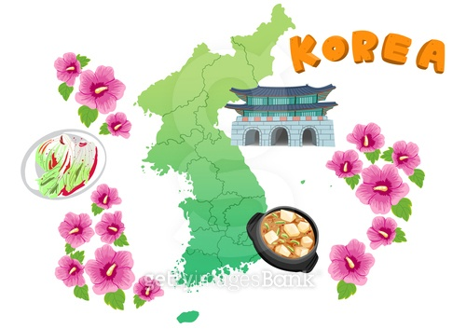
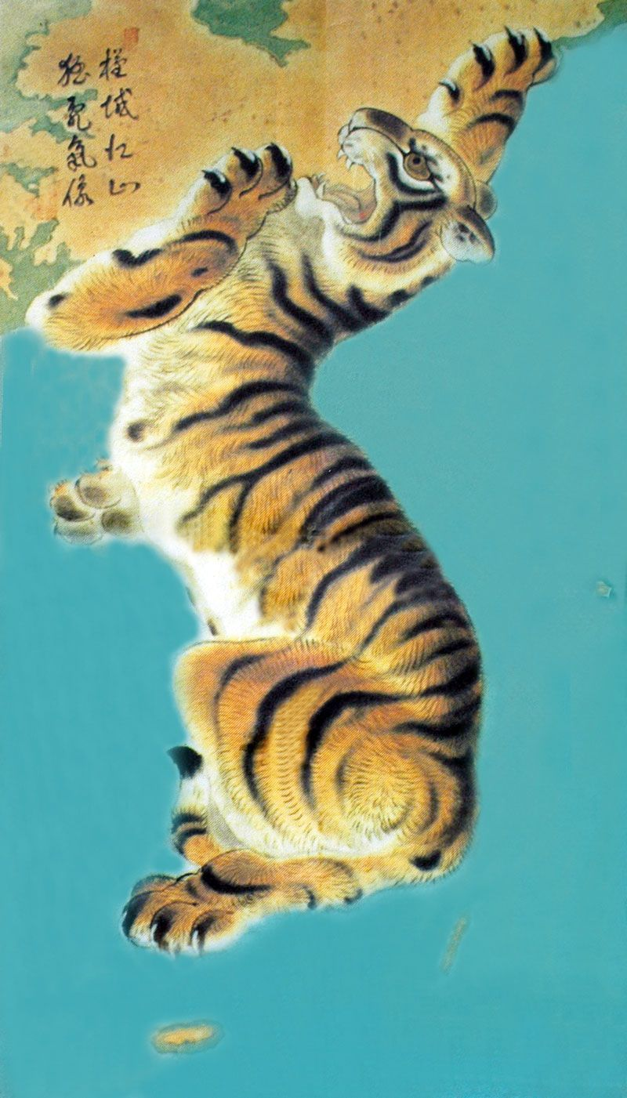
한국의 상징들
Notes:
What are some symbols that represent Korea? Some examples include the Korean flag 태극기, the Rose of Sharon 무궁화, the Korean national anthem 애국가, Korean foods such as 김치, 불고기 and many more.

Slide 4
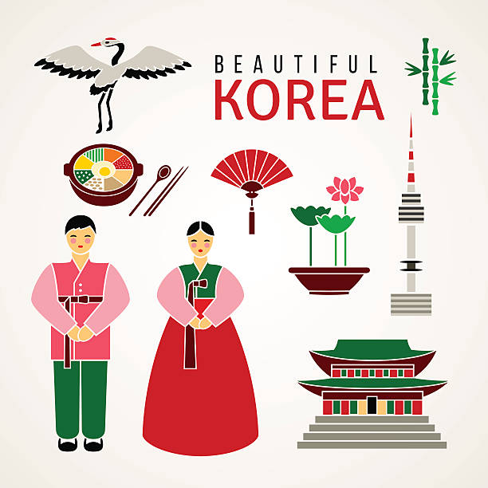

한국의 상징들
Notes:
The pictures shown are more symbols of Korea. Which do you recognize? A Korean fan 부채, 한복, a Korean palace 궁궐, 서울, 태권도, and more.

Slide 5
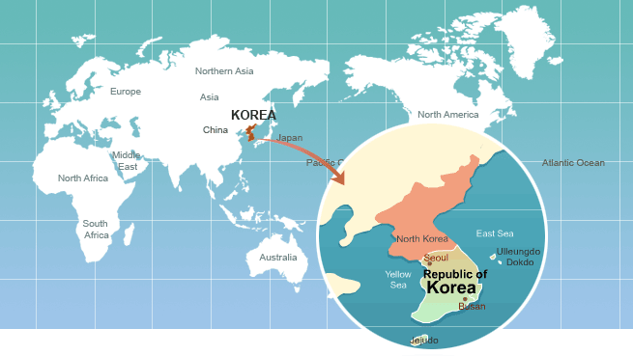
한국찾기
Notes:
This is a world map. Can you find the republic of Korea? Korea is located on the continent of Asia, near China, Japan, and Russia.

Slide 6
한국의 정식 이름
대한민국 大韓民國
Republic of Korea
GREAT HAN PEOPLE COUNTRY
Notes:
The country is referred to as Korea, Republic of Korea, and South Korea, but its official name is ‘The Republic of Korea, 대한민국.’
<click> (글씨 나온 후 설명 자동재생) 대 means Great, 한 means Han, 민 means People, and 국 means Country.

Slide 7
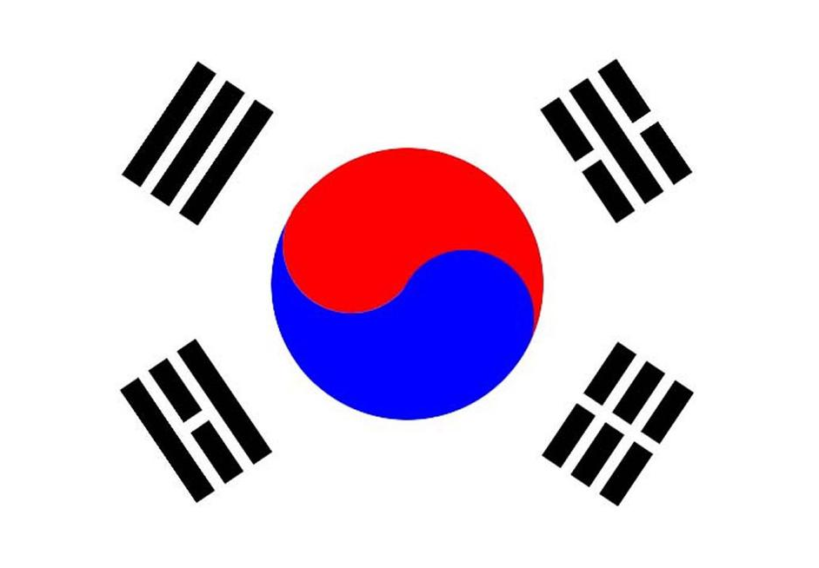
태극기
Flag of Korea
대한민국의국기
Notes:
This is the national flag of the Republic of Korea, 태극기. Have you seen it before? What shapes do you see?

Slide 8
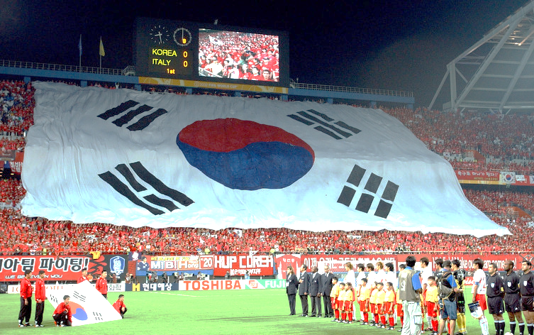
스포츠 경기에서 사용된 태극기
Notes:
This is the 태극기 used at sports events. Can’t you hear the roars of the crowd? (짝짝 짝 짝짝 대~한민국)

Slide 9
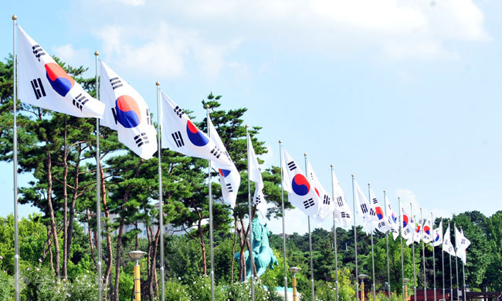
태극기 게양
Notes:
This is a picture of Korean flags blowing in the wind.

Slide 10
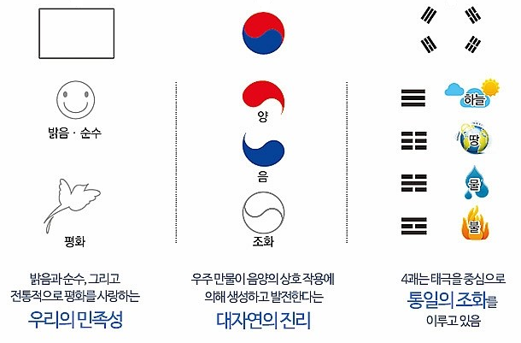
흰색 바탕
밝음과 순수함
평화를 사랑하는 마음
Notes:
Let’s learn about the patterns of the 태극기. First is the background. The white background means brightness and represents purity and the love of peace.

Slide 11
태극 문양
음(YIN)과 양(YANG)이 함께 있어 조화(HARMONY)를 이룸
Notes:
The circle in the center of the 태극기, with the blue 음 and the red 양, together represent harmony.

Slide 12
4괘 (건곤감리)
건 – 하늘
곤 – 땅
감 – 물
리 - 불
Notes:
The four black symbols at the corners of the 태극기 are 건곤감리. The three stripes on the top left are 건 and represent the sky. The four stripes on the bottom left are 리 and represent fire. The five stripes on the top right are 감 and represent water. The six stripes on the bottom right are 곤 and represent land. Therefore, the 태극기 signifies a harmonious world, brightness, purity, and peace.

Slide 13

태극기 동요
https://youtu.be/2z-NaMuTVyk
Notes:
Now we will listen to a song about the 태극기.

Slide 14
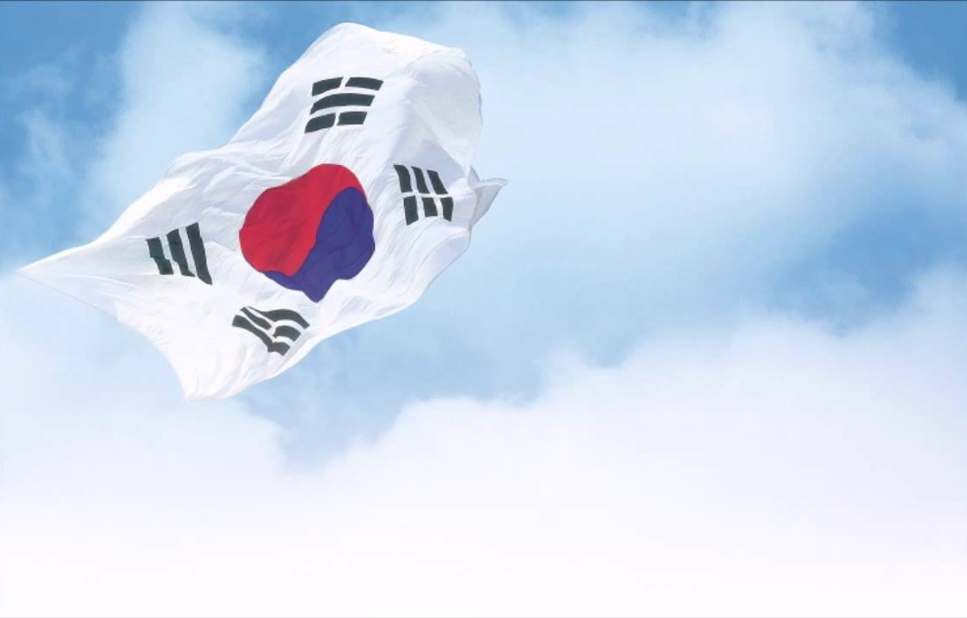
태극기
태극기가 바람에 펄럭입니다
하늘높이 아름답게 펄럭입니다
태극기가 힘차게 펄럭입니다
마을마다 집집마다 펄럭입니다
Notes:
These are the lyrics to the song we listened to. It represents our strong, and beautiful 태극기, blowing in the wind. Shall we try to read it together? (가사 읽기)

Slide 15
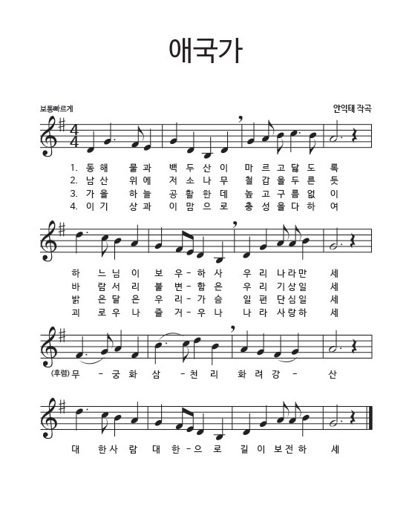
애국가
National Anthem of Korea
대한민국의 국가
나라를 사랑하는 노래
Notes:
The national anthem of Korea is the 애국가. “애” means love, “국” means country, and “가” means song. 애국가 the name itself means a song that loves the country.

Slide 16

애국가 1절
Notes:
Let’s listen to the 애국가 now.

Slide 17
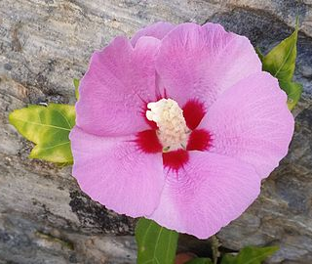
무궁화
National Flower of Korea
대한민국의 국화
영원히 피고 또 피어서 지지 않는 꽃
Notes:
The national flower of Korea is 무궁화 also known as the rose of Sharon. It was chosen as the national flower because the flower blooms all the time and will live forever.

Slide 18

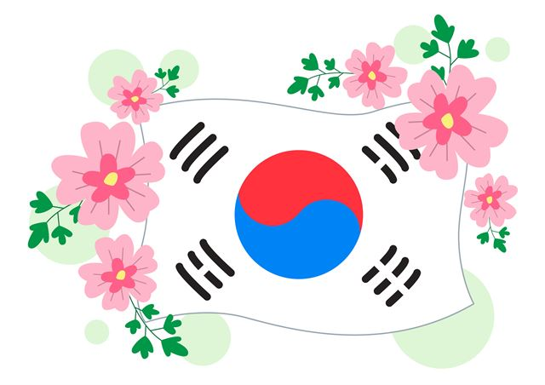
Notes:
Doesn’t Korea look beautiful decorated with 태극기 and 무궁화?

Slide 19
자료 출처
대한민국 응원 음원 파일: https://www.youtube.com/watch?v=sdeF-e_mIG8&t=18s 에서 소리 추출
태극기 동요: https://www.youtube.com/watch?v=mQLTrwpvH-A
애국가 1절: https://www.youtube.com/watch?v=LNCFgfaC9fc

